Slide 1
Consumer to consumer sales management system
By-
Ninad Dighe 1pe16cs100
Parth Sachdev 1pe16cs108

Slide 2
Description and functionality
A consumer to consumer and business to consumer e commerce portal.
Users can buy or sell products on our website.
Users can give reviews and ratings for sellers they buy from.
Discounts and offers will be provided on products based on their categories by the website.

Slide 3
Software stack
Mysql
Html
Css
Bootstrap
Javascript
Node js
Express js
Passport js

Slide 4
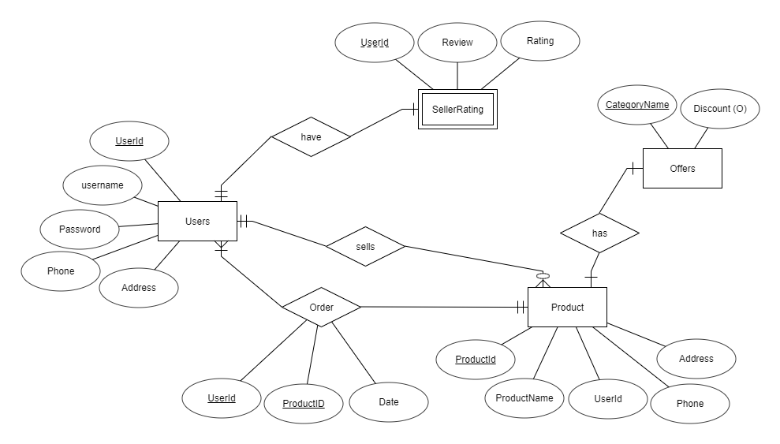
ER Diagram

Slide 5
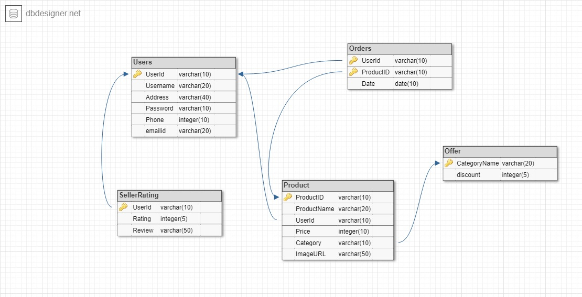
Schema diagram

Slide 6
DATAFLOW DIAGRAM
CATEGORIES
PAGE
PRODUCTS PAGE
Select category
Buy
success
LOGIN
Sell
Choose a product
ADD/REMOVE A PRODUCT
REVIEW PAGE
CONFIRMATION PAGE
After receiving product

Slide 7
3rd normal form
Users : user id, name, password, phone ,address
Product : product id, user id, product name, price, category, image
Offer : category name, offer
Seller rating : seller id, seller rating
Orders : user id, product id, date

Slide 8
Triggers and procedures
Triggers for checking the maximum number of products, length of password, corect format of email, etc.
Stored procedure for checking the correct user login credentials entered.

Slide 9
Thank you

